Slide 1

Practical Arduino
From the Ground Up

Slide 2
Outline (assumes the audience are absolute beginners)
Ohms Law, Components and Symbols. Review Design Objectives.
Schematic vs PCB. Start simple. Work up to this design complete walkthrough. (parts orientation, details, tips and tricks, how to solder, assemble board.) Home work – build some of the board.
Opportunity to share and review. Ask questions. Check work so far. Home work – finish the build
Basic electrical testing. The Arduino IDE. Use of test programs: Blink, Servo etc
Arduino IDE and simple program design. Use of serial monitor for debugging
Examples of practical use (We can decide how deep to go with these but each could be anything from a conversation to its own lesson) - Infrared detectors, LDR sensors, LED outputs, motor control, LCD displays.

Slide 3
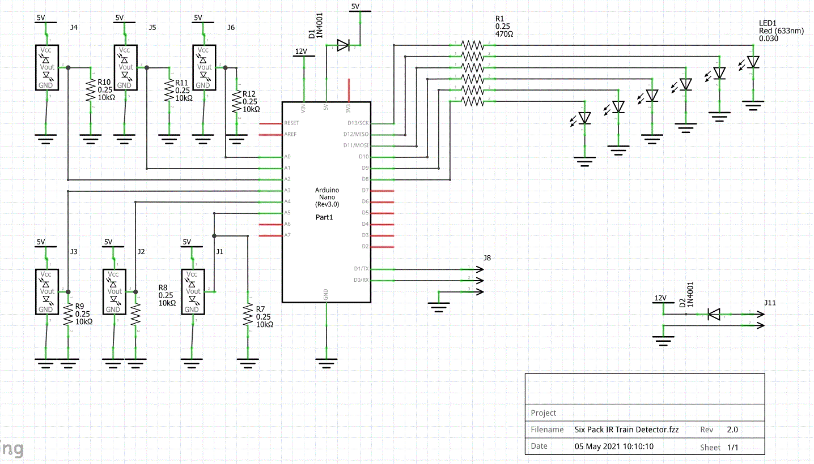
Schematic
Initial Improvement Ideas:
Make pinout of header pins align with standard servo pinout. (currently they align with I/R sensors which as it turns out are not standardized at all)
Increase value of current limiting resistors from 470 ohms to 680 ohms (or higher)
Add 2 board mounted Pushbuttons as DI’s for future experiments and testing.
Find space for a small test area.
Bring out unused digital and analog I/O
Possibly a dedicated header for I2C using A4/A5/+5 and Gnd
NB: Doing all of these would likely increase the size (and cost) of the board which is currently 50mm x 50 mm. (last cost was ~$3 each when I ordered 10 for club use)

Slide 4
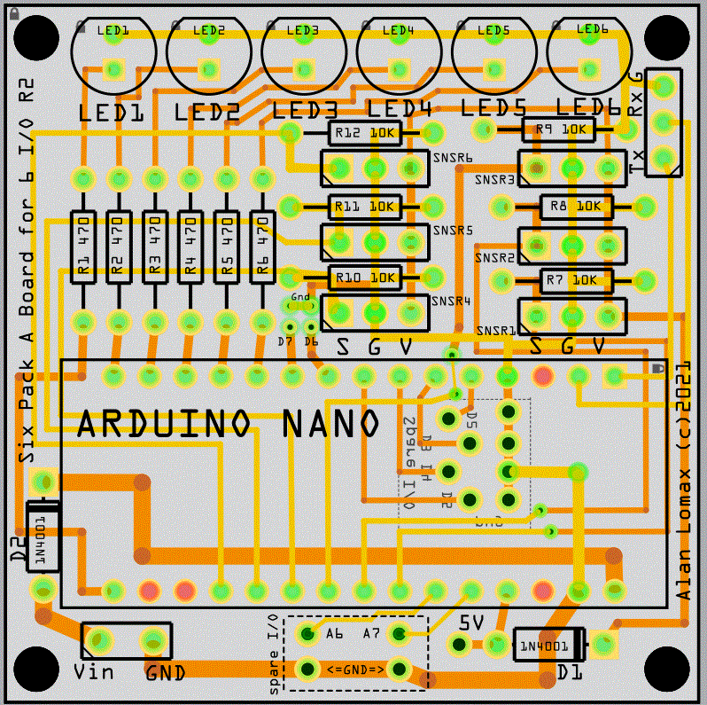
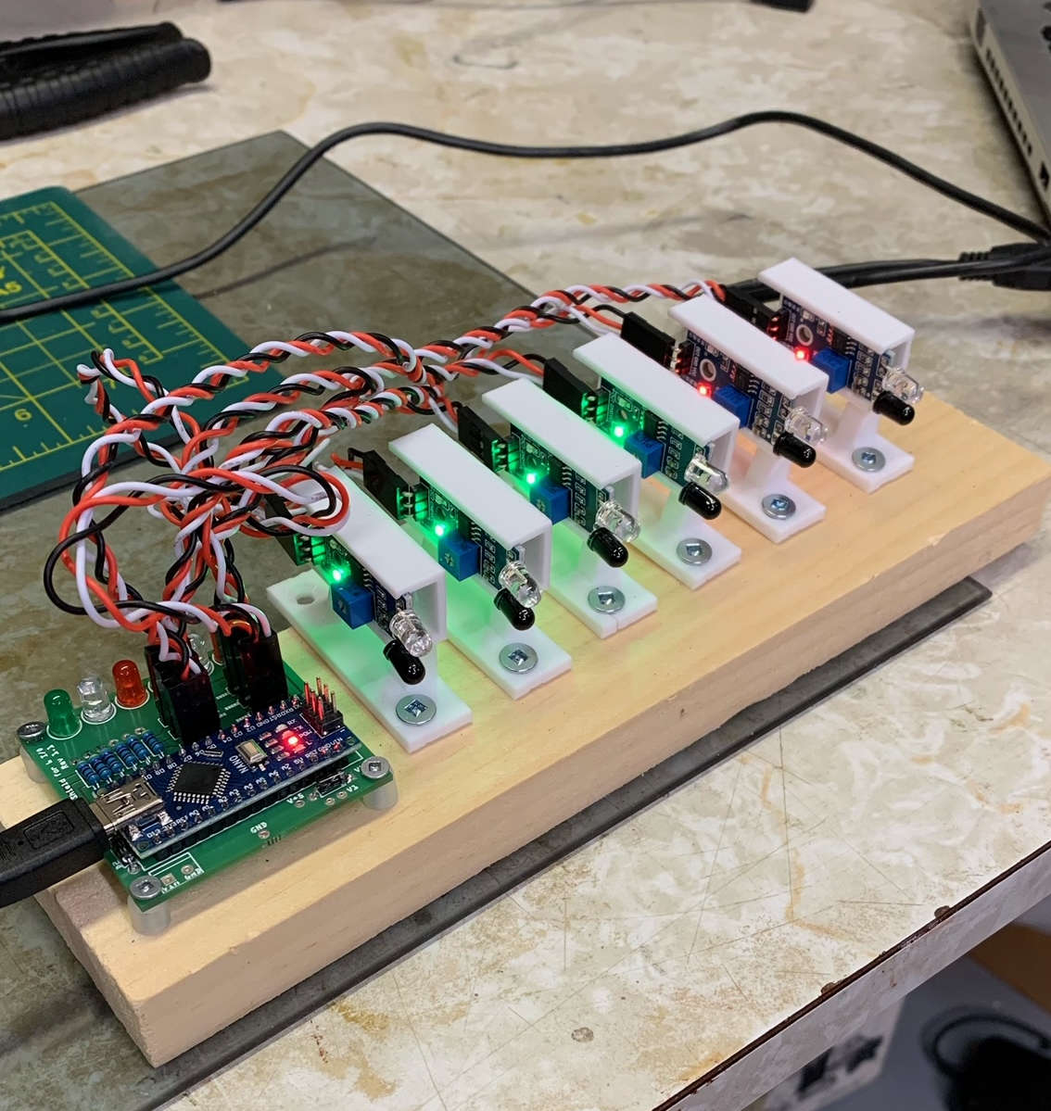
PCB
Photo above is of an R1 (my previous design) To give a general idea of size.
I use this ‘six-pack’ board as a ‘LEGO’ brick for Arduino projects using the NANO.

